Slide 1
PERSONNEL DEVELOPMENT PROGRAM DATA COLLECTION SYSTEM (PDPDCS) RICHELLE DAVIS, OSEP SARAH ALLEN, OSEP MICHELLE BLOOM (ANLAR), OSEP PROGRAM COORDINATOR MIA LELAND (ANLAR), HELP DESK LEAD MANAGER MYRIELL MCKINNON (WESTAT), HELP DESK LEAD
December 6, 2022

Slide 2
Purpose of the Training
Orient grantees to data reporting requirements
Improve the quality of data submitted by grantees
Introduce the Personnel Development Program Data Collection System (PDPDCS)
Data submission requirements for grantees, scholars, and employers
Resources available to you and your scholars
Notes:
This training was planned with project directors, co-project directors, and other key personnel of Personnel Development Program (referred to as PDP) grants in mind. Specifically, those with new 325D and 325K grants funded in FY 2022.
From the start of your grant award period, we want to –
Orient you to data reporting requirements across the award period of your new PDP grant;
Improve the quality of data submitted to Office of Special Education Program (OSEP) by its grantees;
Introduce you to the Personnel Development Program Data Collection System (PDPDCS); including –
Data submission requirements for grantees, scholars, and employers; and
Resources available to you, your scholars, and their employers

Slide 3
Training Agenda
PDP grantee reporting requirements and performance measures
PDPDCS demonstration
Grantee reporting responsibilities for high quality data
Strategies for avoiding security incidents
Reminders for submitting PDP data
Resources and supports

Slide 4
GRANTEE REPORTING REQUIREMENTS
Notes:
As a condition of receiving OSEP support, grantees are required to report annually on their performance. For those with PDP grants, that includes (a) annual reporting on grant project activities and use of federal funds, AND (b) submitting electronic data annually on each scholar who receives “scholar support” from the grant. So to be clear, with a PDP grant, you are asked to BOTH report scholar data annually and to submit an annual grant performance report (APR) to be considered for continuation funding.
The Government Performance and Reporting Act (GPRA) first passed in 1993 and has been reauthorized several times since. It is this legislation that required federally-funded agencies to develop and implement an accountability system based on performance measures and now, to report on the results of those performance measures for each PROGRAM (or investment line).
The administration’s Office of Management and Budget (AKA OMB) approves performance measures that the Department and OSEP uses for this PROGRAM (that is, PDP or all investments made under CFDA 84.325). Likewise, each PROGRAM administered by OSEP (programs such as, the Parent Program, TA&D, Data, and the SPDG) has its own PROGRAM performance measures; some of you may be familiar with those.
Data that OSEP reports for the Personnel Development Program comes from grantees, scholars, and employers. OSEP collects the data used in reporting; specifically, we use a review of syllabi grantees are requested to submit; and data reported to PDPDCS for meeting GPRA reporting requirements for the PDP PROGRAM. However, you, your scholars, and their employers are providing the data we need.
Results are aggregated across grant projects and reported annually to the Department’s Budget Services and Secretary’s Office, the administration’s Office of Management and Budget (OMB), and Congress. That information also is included in the Department’s budget request that is sent to Congress annually and may be used by Congress to determine future funding for this program.
As a result, in addition to its importance in determining continuation funding for your grant project, grantee reporting on performance measures also is a part of the accountability and determinations made on future funding for the Personnel Development Program as a whole. We want to ensure you have a shared understanding of your reporting requirements from the start of your grant as one means to benefit your project and to ensure accountability for the PDP.

Slide 5
325K FY 2022 Absolute Priority 1
Absolute Priority 1: Interdisciplinary Preparation in Special Education, Early Intervention, and Related Services for Personnel Serving Children with Disabilities who have High-Intensity Needs
“Interdisciplinary” refers to scholars participating from two or more graduate degree programs in special education or early intervention and one or more related services through shared coursework, group assignments, and extensive and coordinated field or clinical experiences.
Notes:
On this and the next several slides, you will see the language from the FY 2022 Notices Inviting Applications (NIA) for 325 grant programs supporting the preparation of personnel including first the 325K and then, 325D grant programs. We will highlight some important information about your projects and show you where you can find more information on grantee reporting requirements.
First, “interdisciplinary” projects were the focus as specified in Absolute Priority 1 for 325K grant projects. Interdisciplinary approaches to personnel preparation are intended to provide scholars with experience working and learning in team environments similar to those in which they are likely to work once employed.
For this NIA, the term “interdisciplinary” project was defined as a project that delivers core content through shared coursework, group assignments, and coordinated field experiences as part of two or more master's degree, educational specialist degree, or clinical doctoral degree programs for scholars.
Different graduate degree programs across more than one IHE may partner to develop an interdisciplinary project.
Not all requirements (meaning courses and field or clinical experiences) of each participating graduate degree program need to be shared across all degree programs participating in the interdisciplinary project
For the purpose of this priority, “interdisciplinary” does not include: (a) Individual scholars who receive two or more graduate degrees; (b) one graduate degree program that prepares scholars with different areas of focus; (c) one graduate degree program that offers interdisciplinary content but does not prepare scholars from two or more degree programs together; or (d) one graduate degree program in special education, early intervention, and related services partnering with a graduate degree program other than special education, early intervention, or related services. Programs in which scholars receive only a certificate or endorsement without a graduate degree are not eligible.

Slide 6
325K FY 2022 Absolute Priority 2
Absolute Priority 2: Preparation of Special Education, Early Intervention, and Related Services Personnel Attending Minority Serving Institutions (MSIs), including Historically Black Colleges and Universities (HBCUs), Hispanic Serving Institutions (HSIs), Tribal Colleges and Universities (TCUs), and Asian American and Pacific Islander Serving Institutions (AAPISIs)
Notes:
The purpose of the 325K grant program, Absolute Priority 2 was preparation of special education, early intervention, or related services personnel attending minority-serving institutions (MSIs) including Historically Black Colleges and Universities (HBCUs), Hispanic Serving Institutions (HSIs), Tribal Colleges and Universities (TCUs), and Asian American and Pacific Islander Serving Institutions (AAPISIs).

Slide 7
325K FY 2022 Project Evaluation
Grantees must use comprehensive and appropriate methodologies to evaluate how well the goals or objectives of the proposed project have been met, including the project processes and outcomes;
As well as collect, analyze, and use data related to specific and measurable goals, objectives, and outcomes of the project.
Notes:
All 325K grantees must evaluate their PROJECTS on an ongoing basis.
Specifically, the NIA states that grantees are expected to collect and analyze data on the quality of services provided by scholars who complete the graduate degree programs involved in this interdisciplinary project and are employed in the field for which they were trained including data on the learning and developmental outcomes (e.g., academic, social, emotional, behavioral), and on growth toward these outcomes of the children with disabilities who have high-intensity needs.
Grantees should keep in mind the scholar competencies required for completing the preparation program. This includes the competencies expected to result from “interdisciplinary” approaches to personnel preparation and the evidence-based practice areas that OSEP required (assessment, behavior, instructional strategies, inclusive practices, and as relevant, literacy and numeracy).

Slide 8
325K FY 2022 Priority Language: Project Evaluation - continued
The methods of evaluation must produce quantitative and qualitative data for objective performance measures that are related to the outcomes of the proposed project; and
The methods of evaluation must provide performance feedback and allow for periodic assessment of progress towards meeting the project outcomes.
Notes:
The methods of evaluation that grantees will use to report include both quantitative and qualitative data for performance measures. These evaluation results will be reported to OSEP through the PDPDCS and in your annual and final performance reports.
Again, grantee reporting has implications for continuation funding for each grant project and it also is a part of the accountability for the Personnel Development Program as a whole.

Slide 9
325K FY 2022 Priority Language: Support for Service Obligation
Consistent with 34 CFR 304.30, each scholar must
Receive support for no less than one academic year, and
Be eligible to fulfill service obligation requirements following degree program completion. Funding across degree programs may be applied differently.”
Notes:
In addition to grantee reporting requirements, Project Directors are required to inform scholars about their service obligation commitment and disburse the “scholar support” provided with federal funds.
To meet the requirements, each scholar must: (a) receive “scholar support” for no less than one academic year, and (b) be eligible to fulfill service obligation requirements following degree program completion.
Grantees have responsibility for ensuring scholars understand the service obligation requirements that come with scholar support.

Slide 10
325D FY 2022 Priority Language
Absolute Priority: Preparation of Special Education, Early Intervention, and Related Services Leadership Personnel
Notes:
The purpose of the Absolute Priority is to support existing doctoral degree programs that prepare special education, early intervention, and related services personnel at the doctoral degree level who are well qualified for, and can act effectively in, faculty positions in IHEs as researchers and special education/early intervention/related services personnel preparers in IHEs, or as leaders in SEAs, LAs, LEAs, or EIS programs.
This priority will provide support to help address the identified needs for personnel with the knowledge and skills to establish and meet high expectations for each child with a disability. Programs must culminate in a doctoral degree (Ph.D. or Ed.D.).

Slide 11
325D FY 2022 Priority Language: Recruitment
Applicants must plan to recruit and enroll the proposed number of scholars in the application within the first 12 months of the project period or demonstrate that scholars enrolled after the first 12 months can complete the program by the end of the proposed project period.
A revised project budget must be submitted to OSEP should the project not be able to recruit and enroll the proposed number of scholars that can graduate from the program by the end of the project period.
Notes:
As grantees, you should plan to recruit and enroll the proposed number of scholars listed in the application within the first 12 months of your project or demonstrate that those enrolled after the first year will still be able to complete the program by the end of the proposed project period.
You must submit a revised project budget to OSEP if you are not able to recruit and enroll the originally proposed number of scholars.

Slide 12
325D FY 2022 Priority Language: Project Evaluation
Grantees must evaluate how well the goals or objectives of the proposed leadership project have been met. This includes both scholar and project outcomes, particularly the acquisition of scholars' competencies.
Collect, analyze, and use data on current scholars and scholars who graduate from the program to improve the proposed program on an ongoing basis.
Notes:
As noted here, grantees must evaluate their PROJECTS on an ongoing basis.
This means you must collect, analyze, and use data on current scholars and completed scholars to evaluate how well the goals or objectives of the project have been met and improve the program on an ongoing basis. In your application, you should have described the outcomes to be measured as well as the methodologies.
Again, evaluation results will be reported to OSEP in the annual and final performance reports.

Slide 13
Other Important Items to Note
Obtain prior approval from the OSEP project officer will be before admitting additional scholars beyond the number of scholars proposed in the application and before transferring a scholar to another OSEP-funded grant;
Ensure that the institution of higher education (IHE) at which scholars are enrolled in the program will not require those scholars to work (e.g., as graduate assistants) as a condition of receiving support (e.g., tuition, stipends) from the proposed project, unless the work is specifically related to the acquisition of scholars' competencies or the requirements for completion of their personnel preparation program.
Notes:
There are several other items that we want you to make note of; including --
-Ensuring you receive approval from your OSEP project officer before admitting more (or less) scholars that you outlined in your project application; and
-Ensuring that scholars are not required to work in any position not directly related to their training as a condition of receiving support. In other words, scholars may not work to “pay off” their scholarship to the university.

Slide 14
Grant Performance Reports: APR
Annual Performance Reports (APR)
OSEP will send instructions for preparing and submitting APRs to grantees prior to February 1 annually
APR Resources (https://osepideasthatwork.org/resources-grantees/program-areas/personnel-development-improve-services-and-results-children?tab=pa-measurement)
Deadline for submitting is COB on the first Friday in May (4:30 pm ET)
Submitted in G5 (http://www.g5.gov)
Notes:
In addition to reporting scholar data using the PDPDCS, PDP grantees are required to complete and submit an Annual Performance Report (aka “APR”) and a Final Performance Report no later than 90 days after the end of the grant award project. APRs are submitted in G5 no later than the first Friday in May.
In general, the APR will ask for information on (a) your progress implementing the project outlined in the grant project funded; including activities you proposed to completed to meet goals and objects outlined for your grant application, scholar performance related to the PROGRAM performance measures, and so forth; and (b) management of federal and non-federal funds.
Each year, OSEP, on behalf of the Department, will email Project Directors and Authorized Users the instructions on preparing and submitting APRs prior to February 1. The instructions come in the form of a Dear Colleague Letter from Larry Wexler, the RTP Division Director.
These APRs will be used to make decisions about continuation funding for Year 2 of your grant award.
The link to the APR resources includes several recorded trainings as well as other supports to assist you with this effort. Your project officer will have information to share and is a good resource if you have any questions. Many grantees submit a draft APR to their project officer in mid- to late March, so the Project Officer has an opportunity to review and provide feedback prior to the submission deadline. I encourage you to take advantage of that opportunity for review and feedback; most grantees report that they find it really helpful.
OSEP requires that a performance report is on file every 12 months, including during time you might have a no cost extension.

Slide 15
Grant Performance Reports: FPR
Final Performance Report
OSEP instructions will clarify which portions require updates, summaries of the full award period, and/or new information
Due no later than 90 days after end of project award period
Submitted in G5
Notes:
A Final Performance Report is due no later than 90 days following the end of your award period. The Final Performance Report has similar, but not the same requirements as the APR. Carefully review the Instructions to clarify which portions of the report requires only an update from the time of your last APR, which requires reporting for the full grant award period (5 years), and which asks for new information.
Please keep these timelines in mind and begin now to establish the practices needed to fulfill reporting requirements.

Slide 16
OVERVIEW OF PROGRAM PERFORMANCE MEASURES

Slide 17

PDP Performance Measures Purpose
Helps measure whether the PDP is meeting its objectives.
Demonstrates PROGRAM progress and effectiveness over time.
Used by Congress to determine future program funding.
Required under the Government Performance and Results Act (GPRA).
Notes:
Your grant must report on two types of measures, GPRA performance measures – also known as PROGRAM measures - (required of all grants funded under CFDA 84.325) and PROJECT performance measures (which are unique to your project). This section of the training will focus on PROGRAM (or GPRA) performance measures; those measures that all grantees must report on with a PROJECT-level performance measure that is aligned.
First, let’s discuss the overall purpose of performance measures. As mentioned earlier, the Office of Management and Budget (OMB) established GPRA performance measures for OSEP’s Personnel Development Program as it does for all discretionary grant programs across the federal government. These measures were designed to allow OSEP to measure and report the extent to which the PDP is meeting the goals outlined in IDEA for the appropriated funds.
OSEP collects the data for these measures annually; uses that data to monitor PDP’s performance toward meeting its targets and goals; and demonstrates the effectiveness of these grant programs over time.
The results that you report on each performance measure are aggregated and reported to the Department’s Budget Services and the Secretary’s Office, the administration’s Office of Management and Budget, and Congress on an annual basis. This information also is included in the Department’s annual budget request that is sent to Congress. Congress uses this information to determine future program funding, so it is important.

Slide 18

PDP Government Performance and Results Act (GPRA) Measures
Sources of Data:
Grantee enters data in PDPDCS for each scholar receiving support on grant at -
Enrollment,
Annually during enrollment, and
Exit (e.g., complete degree program)
Scholar enters employment information
Employer(s) verify employment
Notes:
For PDP, the sources of data used to report on GPRA or PROGRAM performance measures comes primarily from information that grantees, scholars, and employers enter into the PDPDCS for each scholar.
To fulfill PROGRAM performance reporting, grantees need to report within the PDPDCS for each scholar at the following times --
Enrollment (when a scholar enrolls in the degree program and accepts “scholar support”). Grantees must submit the signed Pre-Scholarship Agreement and information about the scholar, including contact information, demographic information, and training program information such as degree sought, length of the program, and special education areas covered.
Annually; that is, you review and update scholar data annually during the Annual Scholar Data Collection period, and finally, when they
Exit the program. Finally, you report when each scholar “exits” the project. When an OSEP Scholar is no longer receiving “scholar support” you need to report to PDPDCS and specify why. Is the scholar is “exiting” because they completed the degree program and is graduating? Did the scholar “exit” without completing the program due to personal reasons, a transfer, or the grant is ending?
NOTE: Each scholar who is entered into PDPDCS, ultimately must be “exited”. If your scholars are still enrolled at the time your grant ends, you still MUST exit your scholars and note that they exited without completion due to grant ending.
Additionally, SCHOLARS submit their employment information. After completing one academic year of training with “scholar support,” scholars may enter employment in PDPDCS.
Finally, EMPLOYERS must verify employment of scholars. Employment data are (a) required for fulfilling service obligation, and (b) used collected and analyzed to fulfill the PDP PROGRAM performance measure reporting requirements.

Slide 19

PDP PROGRAM Performance Measure 1
The percentage of preparation programs that incorporate evidence-based practices into their curricula.
Source of data: Expert panel review of syllabi from PDP grantees conducted one year following the grant award.
Syllabi from FY 2022 grants will be
reviewed & results reported in FY 2023
Syllabi submitted in application AND new or revised syllabi submitted to OSEP will be used
More information will follow in Year 1
Notes:
Here, on this slide, you will see PROGRAM Performance Measure 1 along with the data source we use to report on this PROGRAM performance measure. Specifically, …
Measure 1 is the percentage of preparation programs that incorporate scientific or evidence-based practices into their curricula.
For Measure 1, the data source is the syllabi that were provided in your applications along with any new or updated syllabi that you submit to OSEP in Year 1 of your project. An expert panel will review the syllabi for the FY 2022 grants during the 2023 reporting period. If you have developed syllabi for new courses during a program planning year or updated syllabi in Year 1, you may submit those syllabi to your project officer.
As noted in the 2022 Notice Inviting Applications, OSEP Scholars should be prepared using coursework and aligned practice-based opportunities (in class and field experiences) to build competencies in the following evidence-based practice areas:
For 325K those areas include -
Assessment,
Behavior (social, emotional, behavioral learning),
Instructional practices,
Inclusive strategies,
Literacy and numeracy development,
Interdisciplinary practices, and
Distance learning technologies and pedagogy
For 325D, the focus of Measure 1 is on research methods, evaluation methods, or data analysis courses required by the degree program.

Slide 20

PDP PROGRAM Performance Measure 2
The percentage of scholars completing preparation programs who are knowledgeable and skilled in evidence-based practices for children with disabilities.
Source of Data: Grantees enter data into the PDPDCS regarding scholar’s exit/completion status and their chosen measure.
Grantees must include at least one measure to demonstrate each scholar is “knowledgeable and skilled in use of EBPs” for children with disabilities.
Notes:
Measure 2 examines the percentage of scholars completing OSEP-funded preparation programs who are knowledgeable and skilled in evidence-based practices for children, including infants and toddlers, with disabilities.
OSEP expects that all grants will have identified at least one measure demonstrating knowledge of and skills in using evidence-based practices (EBPs) for all scholars who complete each degree program will take.
We recommend that you conduct an exit interview with each scholar as they prepare to exit their degree program. During that interview you will want to collect any additional data you need to complete the scholar’s record in the PDPDCS; including results on any test(s) of knowledge or skills that scholars have completed.

Slide 21
PDP GPRA Performance Measure 2 - continued
Examples of Measures of Knowledge and Skills
ACCEPTABLE Measures | UNACCEPTABLE Measures
Grantee-specific tests (e.g., portfolio, comprehensive exam, dissertation defense) PRAXIS II National organization tests State-specific tests Capstone project or exam required of scholars prior to degree program or grant project completion | Entrance exams (e.g., PRAXIS I, GRE, SAT) University preliminary exams Individual course exams or grades
Notes:
Here are examples of acceptable measures and unacceptable measures that would demonstrate that a scholar is knowledgeable and skilled in use of EBPs. These options will also be shown within the scholar record once you indicate that a scholar has completed or graduated.
You will need to know whether scholars have completed and passed each measure. If necessary, establish it as an expectation that they report the results to you; perhaps include a copy of the results in their official file.

Slide 22
PDP PROGRAM Performance Measure 3
The percentage of scholars who exit preparation program prior to completion due to poor academic performance.
Source of data: Grantees report scholar’s exit/completion status and reason for exiting prior to completion, if applicable.
Notes:
Measure 3 is the percentage of scholars who exit preparation programs prior to completion due to poor academic performance.
OSEP has been very pleased with grantee performance on this measure. Consistently we have reported less than 2 percent of scholars exit due to poor academic performance.

Slide 23
PDP PROGRAM Performance Measure 4
The percentage of scholars completing preparation programs who are working in the area(s) for which they were prepared upon program completion.
Sources of data:
Grantees report scholar’s training area and exit/completion status.
Scholars and employers report scholar’s employment area after exit.
Notes:
Measure 4 examines the percentage of scholars (those graduate students who received “scholar support” from the OSEP-funded grant) completing the preparation program (that is the degree program and grant project requirements) who are working in the area(s) in which they were prepared upon program completion.
Scholars will submit their employment data, which is verified or disputed by the employer. During this process, the scholar and employer agree upon the area or areas in which the scholar is working. The scholar selects a special education area, similarly to the list of areas that the grantee chooses to describe the training program.
Our goal is for you to have as many (or more) program completers as specified in your grant application. OSEP and the Department monitor those numbers quarterly and expect grantees to meet that goal.

Slide 24

PDP PROGRAM Performance Measure 5
The Federal cost per scholar who completed the preparation program.
Sources of data:
ED G5 database provides financial data for each grant; and
Grantees report in G5 scholars funded under 84.325 grants who exited the training program through completion.
Notes:
Measure 5 examines the Federal cost per scholar who completed the preparation (degree) program.
The data for Measure 5 are retrieved by OSEP using –
1. The Department’s G5 database that houses financial data for each grant; and
2. G5 data reported by the grantees on the total amount of “scholar support” provided.

Slide 25
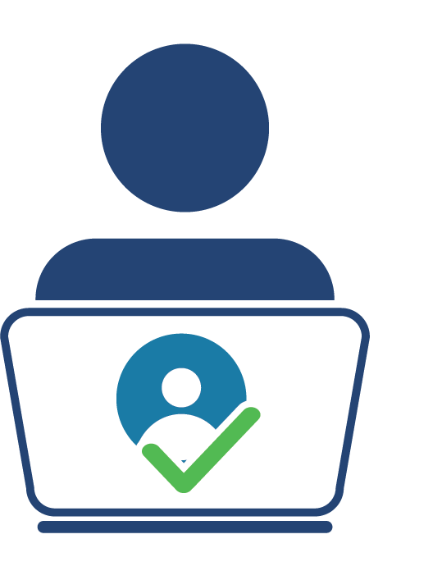
PDP PROGRAM Performance Measure 6
The percentage of scholars who completed the preparation program and are employed in high-need districts.
Source of data:
Scholars who have completed the preparation program and their employers have verified their employment.
CCD and School Universe surveys determine if a district is labeled as high-need.
Notes:
Measure 6 is the percentage of scholars who completed the preparation program and are employed in high-need districts. OSEP and PDP have defined “high-need districts” in the NIA to include high-poverty LEAs, implementing a comprehensive support and improvement plan, or implementing a targeted support and improvement plan.
The data for Measure 6 are retrieved by OSEP using –
The scholar submits information about employment; the employer reviews and verifies the scholar’s employment information.
For scholars who have verified employment only - The Common Core of Data (CCD), Local Education Agency (School District) Universe Survey and Public Elementary/Secondary School Universe Survey, is the second data source for this measure. Districts where the scholars are employed are matched to districts in the CCD to determine if a district is high-need district.
Please note that this measure does not apply to 325D grantees with a focus on preparing faculty.

Slide 26

PDP PROGRAM Performance Measure 7
The percentage of scholars who completed the preparation program and are rated effective by their employers.
Source of data:
Scholars who have completed their program and choose to submit their employment information; and
Employers rate the scholar’s effectiveness during the verification process.
Notes:
Measure 7 examines the effectiveness of scholars who completed the preparation program using 5-point Likert-type rating scale completed by employers.
The data for Measure 7 are retrieved by OSEP using –
Scholar’s employment data
During the employment verification process within the PDPDCS, one of the questions requires employers to rate the scholar’s level of effectiveness in their position.

Slide 27

PDP PROGRAM Pilot Outcome Measure
The percentage of scholars who completed the preparation program and are employed in the field of special education for at least two years.
Source of data:
Grantees report scholar’s exit/completion status.
Scholars and employers report scholar’s employment area after exit.
Notes:
In addition to the approved PROGRAM performance measures already discussed, PDP has worked with OMB to outline an OUTCOME measure for PDP. Our team is collecting baseline data to determine if this is an adequate PROGRAM performance measure to institute in the future.
As with other PROGRAM performance measures, OSEP collects the data needed to report on this OUTCOME MEASURE. For this specific measure, data are retrieved by OSEP using –
PDPDCS data on scholars’ program completion status reported by grantees, and
Employment data reported by scholars and verified by their employers

Slide 28

PDP PROGRAM Measure 325D Grants
Scholar Accomplishments
Publications
Presentations
Honors / Awards
Courses taught
Other
Source of data:
Grantees report scholar’s accomplishments on the APR and in Final Performance Report
Notes:
For 325D grants, OSEP also requires reporting of OSEP Scholar Accomplishments annually.
Accomplishments such as those listed here are reported on the Annual Performance Report. More details will be included in the APR instructions.

Slide 29
USING THE PDPDCS: LIVE DEMONSTRATION
Notes:
To view the live demonstration, please use the YouTube recording link: OSEP PDPDCS Fall 2022 New Grantees Training Webinar Recording – YouTube or type https://youtu.be/YlfoiIdJGW0 into your browser.
The demonstration includes the following steps for grantees:
Logging into the system
Updating grant and contact information
Adding a secondary user
Using the digital Pre-Scholarship Agreement (PSA) or uploading a physical PSA and entering scholar data
Updating scholar data
Tracking scholar’s service obligation fulfillment
Using the digital or physical Exit Agreement (EC) to exit a scholar

Slide 30
PDPDCS SUBMISSION REQUIREMENTS

Slide 31
PDPDCS Data Submission Process
OSEP awards grant
Grantee recruits and selects scholars
Grantee assures that scholars meet regulatory requirements before receiving federal funds
Grantee provides scholarship assistance and grantee/scholar complete Pre-Scholarship Agreement
Grantee submits and updates scholar data
Scholar fulfills obligation through service
Scholar exits program and grantee/scholar complete Exit Certification
Scholar elects cash repayment or is not in compliance
Scholar submits employment
Scholar referred for cash repayment
Employer verifies employment
31
Notes:
This chart depicts the entire data submission process.
To start, grantees receive a grant from OSEP, followed by the grantees recruiting and selecting scholars to participate in the training program. During the recruitment process, you should meet with scholars, and you are required to provide several important documents to them:
The 2006 regulations: https://pdp.ed.gov/OSEP/Regulation/ProgramRegs2006
The FAQs: https://pdp.ed.gov/OSEP/Content/pdf/2006faq.pdf and https://pdp.ed.gov/OSEP/Content/pdf/DCS_FAQs.pdf
The Pre-scholarship Agreement and Exit Certification language: https://pdp.ed.gov/OSEP/Home/Agreements/ , however the exit certification should not be signed until the scholar has completed/exited the grant training program.
The grantee then awards the funds to the scholar and both scholar and grantee complete the Pre-scholarship Agreement (or PSA). Once the PSA is completed and signed, the grantee will enter the scholar’s information into the PDPDCS. We have created a new resource to assist grantees with gathering the required information that we will share at the end of this presentation.
The scholar then begins the training program. After one academic year, the scholar may begin fulfilling the service obligation, but it is not until the scholar has completed OR exited the program that the grace period of 5 years begins. Grantees will need to update the date that the scholar completed one academic year in the PDPDCS.
If a scholar does not complete one academic year of training, that scholar will be referred for repayment. If the program is less than one year in duration, that scholar must complete the program in order to fulfill the service obligation. If a scholar does not complete one academic year of training, even if the program is less than one year in duration, that scholar will be referred for repayment.
When a scholar either graduates from the program or exits prior to completion, both the grantee and scholar must complete and sign an Exit Certification prior to exiting the scholar from the PDPDCS.
The scholar has the option of fulfilling their obligation through service or through cash repayment. If a scholar chooses to fulfill through service, the scholar will submit eligible employment information in the PDPDCS and the employers verify the information. Scholars who elect cash repayment, or who are not in compliance, are referred for cash repayment to the Accounts Receivable and Bank Management Division (ARBMD).

Slide 32
PDPDCS Setup Reminders: Secondary Users
Project Directors are responsible for all data entries; however, secondary users are permitted to assist in the process.
Secondary users:
Can enter scholar information, and
Have a unique log in.
Only three people per grant may access.
Project Directors may change the secondary user(s) at any time.
Note: You may NOT create a shared inbox for your secondary user(s) – each user requires a unique login.
Notes:
PDPDCS recently allowed Project Directors to include an additional secondary user to their grant, for a total of 3 users per grant.
Can enter scholar information, reducing the Project Director’s data entry burden.
Adding secondary users have a unique log in, eliminating the need to share passwords, improving data security.

Slide 33
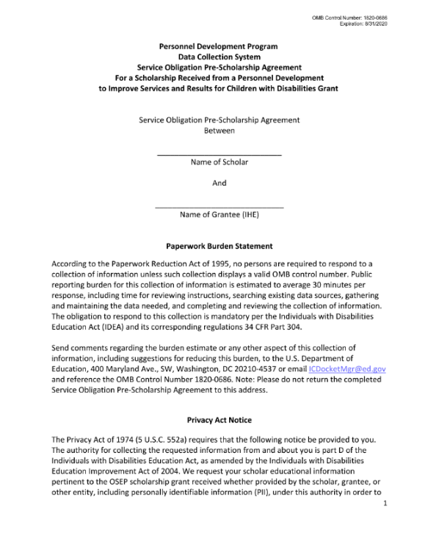
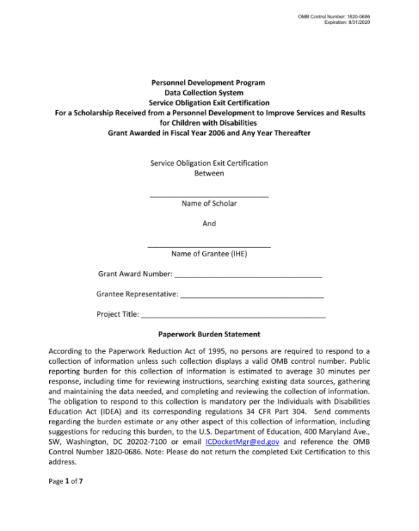
PDPDCS Forms
Grantees and scholars must sign an OMB-approved Pre-Scholarship Agreement and Exit Certification for each funded scholar.
Grantees may be held responsible for funds provided to scholars with missing or invalid documents.
Grantees must retain all grant records until each scholar’s service obligation has been fulfilled or paid back.
Notes:
The legally binding PSA outlines the terms and conditions of PDP funding; grantees are responsible for the accuracy and maintenance of these documents for funded scholars. If you choose to use the digital version of the PSA, please make sure you download and save a copy.
Grantees must retain grant records until all service obligation has been fulfilled or paid back. So please try to stay in touch with scholars until they have completed their service obligation.

Slide 34
Digital PSA Process Overview
Grantee initiates the PSA and fills in scholar information
Scholar receives email notification to review digital PSA
Scholar reviews PSA
PD Reviews PSA then signs and submits
Scholar record is created in the PDPDCS
Scholar signs PSA
Grantee receives notification to edit PSA and makes changes in PDPDCS
Scholar disagrees with information and leaves a comment
Notes:
This slide depicts the digital Pre-Scholarship Agreement process. Using the digital agreement is NOT MANDATORY, and there are no plans currently to require it; however, it is highly encouraged to avoid security incidents that may result from using paper documents.
Answers to common questions:
PDs and secondary users can initiate the digital PSA, but only the project director can sign the final agreement
You will be able to download a redacted PDF of the signed agreement from the PDPDCS.
When completing the digital agreement, grantees still need to fill out the scholar’s contact information in Section B and section C; however Section C is optional.
Regarding the scholar’s SSN: To create a scholar record (either using the digital process or to upload a physical PSA), you will need the scholar’s SSN. If you are using the physical or PDF version of the PSA, you must redact the SSN in the PSA prior to uploading the signed agreement to the PDPDCS. If you use the digital PSA process, the PDPDCS will automatically redact the SSN in the signed version that is converted to pdf that can be downloaded by the user.
If the estimated funding amount in the PSA differs from the final funding amount, that is fine. However, the final funding amount in the EC needs to match the funding amount shown in the PDPDCS.

Slide 35
Digital EC Overview
Grantee initiates the EC from the scholar record
Scholar receives email notification to review digital EC
Scholar reviews EC
PD signs EC
PD exits the scholar in the PDPDCS
Scholar signs EC
Grantee receives notification to edit EC and makes changes in PDPDCS
Scholar disagrees with information and leaves a comment
Notes:
Similarly, the digital EC is not mandatory and there are no plans currently to require it; however it is highly encouraged.
Make sure data is correct in the scholar record BEFORE initiating a digital EC. If changes are required, you must make the necessary changes, SAVE then return to the scholar’s record to start or return to the digital agreement. You cannot make changes after the agreement has been submitted to the scholar.
Scholar will remain in an “Enrolled” status until the digital EC has been signed and finalized and the grantee completes all remaining exit information data fields.
Again, PDs and secondary users can initiate the digital PSA, but only the project director can sign the final agreement

Slide 36

Timeline for Enrolling Scholars
Enter and submit scholar contact and enrollment information within 30 days of scholar enrollment in degree program.
The scholar must have:
Registered for classes
Received “scholar support” from grant project
Signed PSA
Notes:
GRANTEES must enter and submit scholar information into the PDPDCS within 30 days of a scholar “enrollment” in the program. That is, within 30 days of the scholar -
Registering for classes
Receiving funding from the PDP grant project
And signing the Pre-Scholarship Agreement, which can be done digitally. Once the PSA is finalized, grantees will still need to finish creating and submitting the scholar record.
Typically, this occurs within 30 days of the start of the first semester. It would not be prior to classes beginning.
Although the system is available year-round, by the Spring of each year (during the data collection period), grantees are required to have all scholar data up-to-date for all scholars who were enrolled during the previous fiscal year. We recommend logging into the system to make these updates at least every 6 months.

Slide 37
Pending Scholars
OSEP requires that scholars are in a pending status for no more than 30 days.
Help Desk staff will contact you and your Project Officer if your grant has scholars in a pending status at the end of each annual data collection period.
Notes:
Scholars whose information has been entered and “saved for later” will be in a pending status. Scholar records must be “submitted” to ensure their information is complete and can be captured for reporting on the PDP PROGRAM performance measures. Clicking “save and submit” on each scholar record will allow the scholar to access their record within the PDPDCS and begin entering eligible employment, if applicable.
Scholars cannot remain in a “pending” status for longer than 30 days and scholar records cannot be “submitted” until all required items are entered.
PDPDCS Help Desk will identify grantees who fail to “submit” timely, accurate, and complete scholar data and will take appropriate actions, including referring to OSEP any noncompliant grantees. Your project officer will then contact you to discuss why you have not submitted scholar data.

Slide 38
Timeline for Updating and Exiting Scholars
Update scholar contact and program completion information within 30 days of:
Scholar status changes
Enrolled but no longer funded
Exited Prior to Completion
Graduated
Grant budget period ending
Note: Scholars are not fully considered exited until the EC has been signed AND the scholar’s record has been submitted.
Notes:
Timeline for updating and exiting scholars – note that “exiting” here refers to either graduating or exiting prior to completing the program.
Grantees’ must update scholars’ information within 30 days of a change in a scholar’s status. For example, a grantee will need to change the scholar’s status in the PDPDCS within 30 days of that scholar graduating or exiting prior to completing the program.
When exiting a scholar using the digital Exit Certification, there are two steps to keep in mind. Grantees must first fill out the agreement and ensure it is signed and finalized by the PD and scholar. THEN the grantee can officially exit the scholar by completing the rest of the scholar record in the PDPDCS and submitting it.
The burden falls on the grantee to follow-up with the scholar and ensure the agreements are signed within the required 30-day timeframe prior to official exit from the training program.
Lastly, by the time your grant budget project ends (5 years), you must “exit” all scholars before submitting the Final Performance Report.

Slide 39

Scholar Submission Requirements
Once a scholar record is submitted by the grantee, scholars will access the PDPDCS to:
Confirm contact information;
Review training information;
View service obligation status; and
Enter eligible employment information to fulfill their service obligation.
Notes:
When scholars login to the system, they should review the information entered by the grantees. After scholars have completed one academic year of their preparation (or training) program, they are eligible to begin entering employment toward fulfilling their service obligation. Scholars may begin receiving credit for employment while they are enrolled as long as they have completed the academic year.
It is very important to you, as grantees, to update the PDPDCS with the date that scholars have completed one year of academic training with scholar support so that the scholars may begin entering their employment. Once that date is entered, it will activate the link on the scholar side that allows scholars to begin entering employment.
Please ensure your scholars log on to the PDPDCS at least once every year to review information and become familiar with the process using PDPDCS, even when they are still enrolled. ALSO teach them to login every year to verify employment after graduating.

Slide 40
Service Obligation Requirements
Requirements for employment to be deemed eligible:
Paid position, not funded by an OSEP grant program
Cannot be part of an internship, practicum, or other work-related requirement of the scholar’s completion of the preparation program
Notes:
FAQs for service obligation: https://pdp.ed.gov/OSEP/Home/faq2006#6

Slide 41
Service Obligation Requirements – continued
Direct Service:
At least 51% of the infants, toddlers, and children to whom the individual provides services are receiving special education, related services, or early intervention services from the individual; or
The individual spends at least 51% of their time providing special education, related services, or early intervention services to infants, toddlers, and children with disabilities.
Indirect Service:
If the position involves supervision including in the capacity of a principal, teaching at the postsecondary level, research, policy, technical assistance, program development, or administration, the individual spends at least 51% of their time performing work related to the scholarship training.
Notes:
The employment position must meet the criteria for direct service or indirect service.
If providing direct or indirect service, the employment positions must meet this criteria.
If serving children, the children served must fall under the definition of eligible children as described in section 602(3) of IDEA (see IDEA section 602(3), https://pdp.ed.gov/OSEP/Regulation/ProgramRegsIDEA602#childdisability for the IDEA definition).
Under section 662 of the Act available on the PDPDCS website at: https://pdp.ed.gov/OSEP/Regulation/ProgramRegsIDEA662.

Slide 42

Scholars’ Employment Record
Information collected includes:
Contact information;
Type of organization;
Dates of employment;
Type of employment;
Full or part time position;
Training area(s);
Whether the position meets PDPDCS time requirements; and
Certification or licensure
Notes:
Scholars will login to the PDPDCS and fill out an employment record with the following information:
Contact information of the organization as well as contact info for a supervisor and/or HR representative
The type of organization, which offers options like a school, hospital, non-profit and others
When the scholar started and, if applicable, ended at this position
The type of employment, meaning is the scholar a special education teacher, a special education paraprofessional, an administrator or supervisor, etc.
If it is a full or part time position
The training area or areas, which line up with the options that grantees will choose for the scholar’s training program
If the scholar spends at least 51% of their time serving special education students and if the percentage of special education students served is over 51%
And lastly, if the scholar has received the appropriate certification or license for this position.
Scholars are responsible for entering their employment information, but grantees can answer questions or assist if needed. Grantees cannot access scholar employment records. Scholars can always be directed to contact the Help Desk with any questions.
We receive many questions about how the service obligation calculator operates. The calculator will only update once a scholar’s employment is verified by the employer. The record cannot contain a future end date, so only previously completed employment can be verified. We recommend reminding your scholars to update their employment every 6 months to 1 year to display an accurate service obligation status on the PDPDCS.
Both legal and ethical issues are associated with service obligation, and we encourage you to talk with scholars about the importance you place on fulfilling this professional obligation from both perspectives.

Slide 43
Employer Submission Requirements
Employers verify employment information within the PDPDCS.
Scholars do not receive credit for service obligation until the employer has verified their employment.
Scholars receive an email when their employment is verified or disputed
Scholars should reach out to their employer to alert them
Notes:
The scholars’ employers use the PDPDCS to review and verify the employment information submitted by the scholars.
Scholars do not receive credit toward fulfilling their service obligation until their employer verifies their employment. NOTE - Scholars are responsible for obtaining their employer’s verification. Please be sure to advise scholars on this requirement! They will receive an email when their employment has been verified or disputed.
We recommend that scholar’s reach out to their employer before submitting an employment record to alert them that a verification email will be coming from serviceobligation@ed.gov.

Slide 44
AVOIDING SECURITY INCIDENTS

Slide 45

Security Incidents
A security incident occurs if personally identifiable information (PII) is potentially viewable to unrelated parties.
Examples from PDPDCS:
Uploading an unredacted Pre-Scholarship Agreement (PSA) to the wrong scholar record
Sending unencrypted documents (Social Security Card, Driver’s License, etc.) in an email to the PDPDCS Help Desk
Notes:
Scholar agreements and records within the PDPDCS contain significant amounts of scholar’s personally identifiable information (PII).
It is the responsibility of the grantees to protect this scholar information. Improperly handling PDP documentation could expose a scholar to potential identity theft and impact the university’s ability to receive future funding from the Department.
We recommend using the digital PSA feature to avoid potentially uploading an unredacted document to the wrong scholar record.

Slide 46
Impacts of Security Incidents on Department Staff
PDPDCS staff must notify the Department’s Education Security Operation Center (EDSOC), document the incident, and expunge the file or email from the servers
Additional interviews, investigations, and mitigation strategies may be necessary
PDPDCS Staff must review all other scholar records and documentation associated with the grantee
Notes:
Every security incident that occurs requires significant resources from the Department to mitigate the impact. These steps require hours of paperwork and Department resources to address. Further, we all want to do our part to protect PII of scholars.

Slide 47
Impacts of Security Incidents on Grantees
Grantees must resubmit scholar documentation, complete security incident report, and participate in investigation interviews as needed
Project Directors and Secondary Users will be required to participate in a security training to understand the proper handling of scholar PII and the consequences of data breaches
The grant will be placed on a security incident list tracked by PDPDCS and OSEP staff. If further incidents occur, the grant and university could be placed on high-risk status, impacting their ability to receive future federal funding
Notes:
In addition to the potential effects of sharing PII, grantees may also encounter these consequences as result of one or multiple security incidents.

Slide 48
Avoiding Security Incidents
Always encrypt files being sent by email, including to the PDPDCS Help Desk.
Use the digital Pre-Scholarship Agreements and Exit Certifications to avoid uploading a document to the wrong scholar record.
Implement a file naming convention to track files associated with each scholar’s record: PSA_J_DOE.pdf.
Notes:
More information on avoiding security incidents and how to encrypt files is available on the PDPDCS training webpage.

Slide 49
HELPFUL PDPDCS REMINDERS

Slide 50

PDPDCS Communication: Always Read System Emails
Notifications regarding system or policy changes as well as data submission reminders are sent via email.
Please add serviceobligation@ed.gov to your contact list.
Check your email settings to be sure emails from this account are not marked as spam.
Notes:
PDPDCS will communicate with grantees, scholars, and employers by email so make sure you have serviceobligation@ed.gov on your contact list. Remind your scholars to add serviceobligation@ed.gov to their contact lists as well.
Copies to project officers and the grant’s Authorized or Certifying Representative are included on some email notifications.

Slide 51
PDPDCS Data Quality: Scholar Contact Information
OSEP and PDPDCS staff must be able to reach scholars after they graduate or leave your IHE. Please enter a non-IHE email address for each scholar.
Personal email (e.g., Gmail, Yahoo, Outlook)
Work email
If the scholar has multiple emails, include a second non-IHE email in the alternative email field.
Notes:
Because scholars will need to login to the PDPDCS for several years after they finish the training program, please use a personal email address for your scholars instead of their school email address. If the scholar has multiple emails, please include the second non-IHE email in the alternate email field so our Help Desk and support team can verify the scholar should the need arise.
We highly recommend that you ask scholars to log in to PDPDCS each year while they are still enrolled in the degree program and receiving scholar support, so they become familiar with the system while still with you.

Slide 52
PDPDCS Reporting: Timely Submission
Submit all data on time (APR, PDPDCS, and FPR).
According to 34 CFR 75.253(a)(3), the timely submission of this report is one of the factors that the Secretary will consider in determining whether to continue your project's funding for next fiscal year.
According to section 75.217(d)(3)(ii), the Secretary can consider the failure to submit scholar data in a timely fashion in determining your project’s ability to obtain future grants from the Office of Special Education Programs or under any other Department program.
Notes:
As an OSEP grantee, you are required to submit data for continuation funding and other reporting, such as performance measures and service obligation.
Failure to submit data or submit data on time can be considered in determining your ability to obtain future grants not only from OSEP by from other Department programs.

Slide 53
Managing PDPDCS Grants and Timelines
Project Directors must manage grants to ensure that:
All scholars can complete the degree program before the grant ends;
Scholars are enrolled early (Year 1) with sufficient time, funding, and support to complete the program; and
The number of scholars proposed, enrolled, and completed meets outlined expectations.
Contact your OSEP Project Officer to discuss changes in the number of or completion status of scholars.
Notes:
It is up to the grantee to ensure that scholars are enrolled with enough time, funding, and support to complete the training program within the grant project period. Please make sure you are making these timing considerations when recruiting.
You need to manage the grant so that all scholars complete the program before the grant ends. A Department priority over the past several years is for projects to end within the established grant project period. OSEP may consider grantees request for a one-time, no cost extension to allow more time –up to 12 months, no new money– for scholars to complete the preparation program and graduate. We want scholars to “complete” the program and be counted as program completers!
A second no-cost extension is unlikely to be approved. Once again, it is important that scholars are recruited and can complete their training program by the end of the grant project period.

Slide 54
Exit All Scholars BEFORE Your Grant Ends
Any scholar who has not graduated/completed or previously exited when a grant closes will be assigned the status of “exited without completion.”
Project Directors are responsible for obtaining Exit Certifications from these scholars too. Service obligation requirements still apply.
Grantees will report the reason or final program completion status for each scholar. For example:
Poor academic performance
Grant ending prior to preparation program completion
Notes:
When OSEP funding ends, at the conclusion of a grant, it is the responsibility of the grantee to “exit” all scholars in PDPDCS. If “exited without completion” is selected, you will be prompted to enter the reasoning. If your grant has ended, please select that option.
ALL scholars MUST sign an Exit Certification upon exiting the program. A scholar that will still be enrolled in the program after funding ends should still be exited from PDPDCS.
If scholars are still enrolled at the time the grant ends, PDPDCS staff will contact you and your OSEP Project Officer to resolve scholar records.

Slide 55
Scholar Reporting Requirements
Recommend to your scholars to review the resources available on the Training Page: https://pdp.ed.gov/OSEP/Home/Training
Notify scholars at the beginning of the program that they will be required to provide licensure test results to you.
Arrange and conduct exit interviews with each exiting scholar.
Notes:
As mentioned at the beginning of this presentation, there are several performance measures that OSEP reports on annually that are based on employment data reported by the scholars. These data have had significant issues in recent years because scholars are not logging into the PDPDCS and submitting their employment information. We need to your help communicating with scholars. Please communicate to scholars the importance of service obligation, and how to login to PDPDCS, report employment, and get employer verification. Results on GPRA performance measures will impact future funding of this discretionary grant program and others that benefit in our field.
Scholars who do not submit eligible employment information that is verified by their employer by the time their service obligation must be fulfilled are not in compliance and will be referred for repayment.
We have several resources available on the Training and Resources page of the PDPDCS for scholars that you should encourage your scholars to view. Please note we will be updating the Training Page in the coming months to make it easier to locate the resources you are seeking.
We highly recommend that you conduct an exit interview with each of your scholars when they exit the program. During that conversation, remind scholars of their obligation and requirement to login to the PDPDCS and report their employment information. Let scholars know that you will be monitoring their progress until their service obligation is completed and encourage them to stay in touch with you and the program. For example, as their contact information changes (e.g., email addresses change), they must report this change in PDPDCS.
Lastly, during that interview, you can collect any additional data you need to complete the scholar’s record in the PDPDCS, including information on their measure(s) of skills or knowledge. This is an important measure that has also experienced issues in recent years. Please work with your scholars to obtain and report this information.

Slide 56
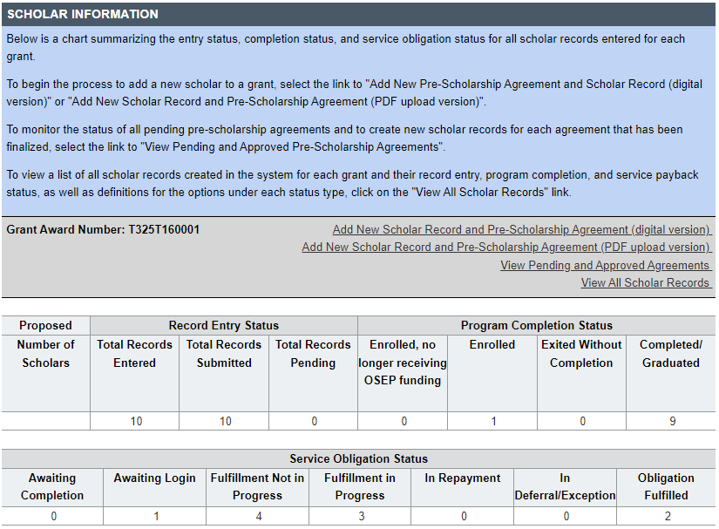
PDPDCS Reporting: Monitoring Scholars
Notes:
After scholars have completed one academic year, each scholar can begin entering eligible employment information in the PDPDCS. Scholars must enter their employment to receive credit towards their service obligation. You can and should monitor whether your scholars have logged into the system and begun fulfilling their service obligation. You need to maintain records on your scholars until all have fulfilled their service obligation.
Upon logging in, you will see this chart at the bottom of your grant page. This summary table has been provided for you to simplify monitoring scholars. Under the service obligation status header, you will be able to easily see which scholars have not yet logged in or begun fulfilling their service obligation. If a scholar has a status of “fulfillment not in progress”, this means either the scholar has not yet entered employment information into the PDPDCS, or the scholar has submitted an employment record, but it has not yet been verified by their employer.
An explanation of the other statuses is listed at the top of the page. Grantee support will ensure OSEP has the data it needs to report on Performance Measures and service obligation results to Federal government authorities.

Slide 57
RESOURCES AND SUPPORT

Slide 58

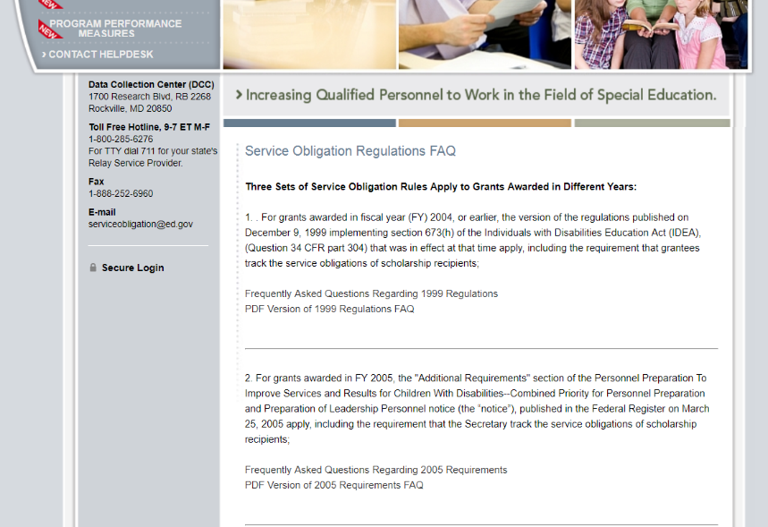
Support Using PDPDCS: Website Resources
PDPDCS resources include:
A closed-captioned recording of this webinar will be made available (https://pdp.ed.gov/OSEP/Home/Training).
PDPDCS Frequently Asked Questions (https://pdp.ed.gov/ OSEP/Home/dcsfaq).
Notes:
A recording of this webinar will be made available on the website for grantees and staff who missed this training or need a refresher. We will also send you an email from serviceobligation@ed.gov with a link to the recorded training as soon as it is available.
In addition, on the website you can find responses to questions frequently asked by grantees, scholars, and employers regarding program regulations and requirements pertaining to the grant funding, links to service obligation regulations and Pre-scholarship agreements and Exit Certifications. Our Help Desk is available M-F 8 am to 8pm EST via phone or email.

Slide 59
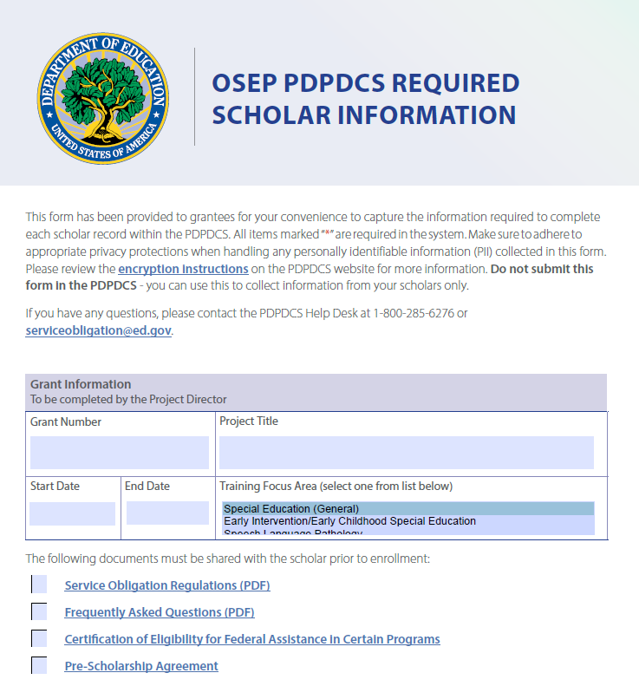
New PDPDCS Resource
Reference document to assist grantees with collecting information from scholars
Not to be submitted into PDPDCS
Adhere to privacy protections
Notes:
Based on feedback we have received from grantees, our team created a new resource to help you gather the information required to fill out the scholar record in the PDPDCS. This fillable PDF can be sent to scholars to have them enter their contact information, but we highly recommend adhering to privacy protections and using encryption when sending this document back and forth. Please DO NOT send this document to the Help Desk.
Once you have gathered the information from the scholar in this document, you can then use it to complete the scholar’s record in the PDPDCS and submit it.
This resource will be included on the website next month. We will also share it with you via email in the coming weeks.

Slide 60
Support Using PDPDCS: Help Desk
The PDPDCS Help Desk is available by phone or email to answer questions you or your scholars may have regarding the PDPDCS. Help Desk support is available:
Monday through Friday from 8 am to 8 pm, ET.
Email: serviceobligation@ed.gov.
Toll Free Hotline: 1-800-285-6276.
If someone is not available when you call, please leave a message. A Help Desk operator will return your message within one business day.
A designated specialist can also spend additional time walking you through components of the PDPDCS. Just contact the Help Desk to set up an appointment.
Notes:
Lastly, please reach out to the Help Desk with any other questions you may have. One of our associates will offer you individual assistance. The Help Desk is available Monday-Friday 8am-8pm Eastern Time. Someone will respond to your inquiry within one business day. We are also happy to set up a specific time to discuss your question though phone or video chat if you like, please contact the Help Desk to set this up.

